Slide 1
563.18 Automotive
Presented by Carl A. Gunter
CS563/ECE524
Advanced Computer Security
University of Illinois

Slide 2
Digital Controls in Automobiles
Digital control, in the form of self-contained embedded systems called Electronic Control Units (ECUs), entered US production vehicles in the late 1970s.
This was driven by legislation like the Clean Air Act of 1970 and pressure from increasing gasoline prices.
By dynamically measuring the oxygen present in exhaust fumes, the ECU could adjust the fuel/oxygen mixture before combustion, thereby improving efﬁciency and reducing pollution.
Notes:
These intro slides are based on ones developed by Gaurav Lahoti

Slide 3
Software in Cars (2009 data)
F-35 Joint Strike Fighter – 5.7M lines of code
Windows XP – 40M lines of code
A premium car in 2009 – 100M lines of code, 70-100 ECUs
Mercedes Benz S-class
  Radio and navigation system – 20M lines of code
  Has as many ECUs as Airbus A 380.
Cost of software and electronics can reach 35 to 40 percent of the cost of the car.

Slide 4
Current Software Functionality
Car controls
Performance monitoring
Automatic crash response / emergency call system
Theft recovery system
Remote execution
Navigation system
App integration – Twitter, Facebook, Google Search, Yelp
Driver monitoring capabilities

Slide 5
Android Auto and Apple CarPlay
Allows smartphone to connect to the car with a rich interface
Car can exchange data and access Internet using the smartphone
Majority of car manufacturers support this; expect implementation starting with 2015 models
Android Auto
iOS CarPlay

Slide 6
First Case Study
Cars have adopted advanced internal vehicular networks of many computers creating risks of cyber exploits on these networks.
The authors empirically tested a car to find vulnerabilities available to attackers who obtain physical access to the cabin of the car.
They demonstrated serious vulnerabilities such as disabling the brakes and stopping the engine while the car is being driven.
[Koscher 2010]
Notes:
Abstract—Modern automobiles are no longer mere mechanical
devices; they are pervasively monitored and controlled by
dozens of digital computers coordinated via internal vehicular
networks. While this transformation has driven major advancements
in efficiency and safety, it has also introduced a range of
new potential risks. In this paper we experimentally evaluate
these issues on a modern automobile and demonstrate the
fragility of the underlying system structure. We demonstrate
that an attacker who is able to infiltrate virtually any Electronic
Control Unit (ECU) can leverage this ability to completely
circumvent a broad array of safety-critical systems. Over a
range of experiments, both in the lab and in road tests, we
demonstrate the ability to adversarially control a wide range
of automotive functions and completely ignore driver input—
including disabling the brakes, selectively braking individual
wheels on demand, stopping the engine, and so on. We find
that it is possible to bypass rudimentary network security
protections within the car, such as maliciously bridging between
our car’s two internal subnets. We also present composite
attacks that leverage individual weaknesses, including an attack
that embeds malicious code in a car’s telematics unit and
that will completely erase any evidence of its presence after a
crash. Looking forward, we discuss the complex challenges in
addressing these vulnerabilities while considering the existing
automotive ecosystem.

Slide 7
Connectivity
On-Board Diagnostics II (OBD-II) port gives access to vehicle buses via their communication protocol.
CAN - Controller Area Network - ISO 11898-[1-6]
  Originated by Bosch in 1983.
  Message based with division into high speed and low speed busses.
  Used by BMW, Ford, GM, Honda, Volkswagen, and others.

Slide 8
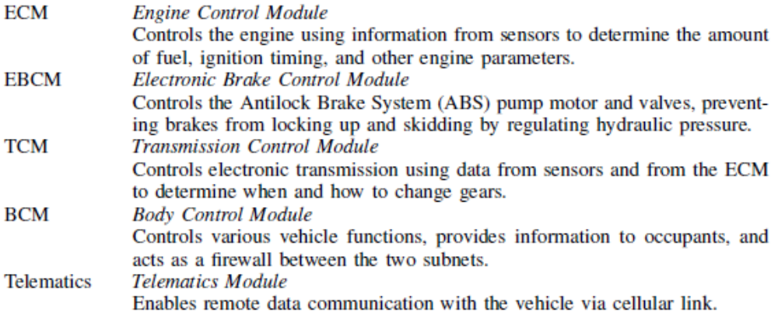
Sample ECUs on High Speed CAN Bus of Test Car
Notes:
BCM controls external lights and their associated brightness.

Slide 9
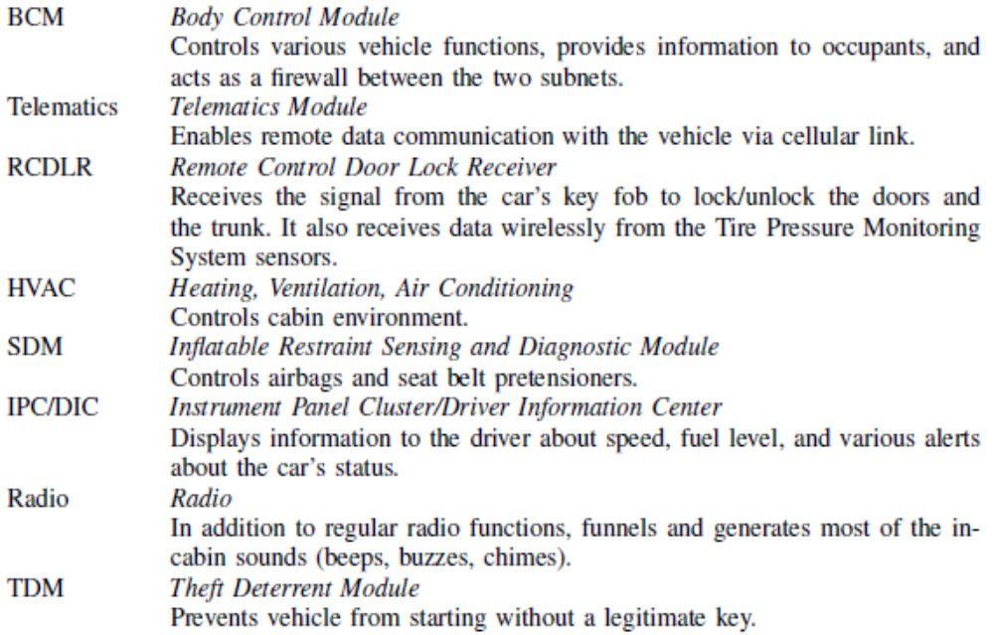
Sample ECUs on Low Speed CAN Bus of Test Car

Slide 10
CAN Security Issues
Packets are broadcast to all nodes: the nodes decide whether to accept the information or not
Packet flooding attack: priority-based arbitration allows node to assert dominant state indefinitely
No source Identifier fields in the packets: any source can send packets to any other node in the car

Slide 11
CAN Security Issues (Continued)
Access control is based on challenge response sequence to protect ECU against certain actions without authorization.
ECUs are expected to use a ﬁxed challenge (seed) for each of these challenge-response pairs.
The corresponding responses (keys) are also ﬁxed and stored in the ECUs.
  Challenges and responses are both 16 bits – can be brute forced
  Many of the seed-to-key algorithms in use today are known by the car tuning community

Slide 12
Deviations from Standards
ECUs should reject commands like “disable CAN communications” when it is unsafe (viz. when the car is moving).
An ECU should reject a request to initiate a programming event if the engine is running.
It should be possible to re-ﬂash the unit only after authentication.
Reading data from sensitive memory areas (viz. challenge responses) should not be allowed.
Gateways between the two networks must only be re-programmable on the high-speed network to prevent a low-speed device from compromising a gateway to attack the high-speed network.

Slide 13
Attack Methodology
Packet snifﬁng and targeted probing
Fuzzing: the range of valid CAN packets is small, signiﬁcant damage can be done by simple fuzzing of packets
Reverse engineering: notably the telematics unit – dumped the code via the CAN ReadMemory service and used a third-party debugger (IDA Pro)

Slide 14
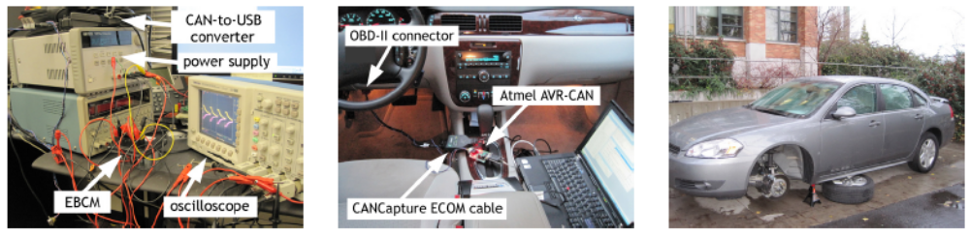
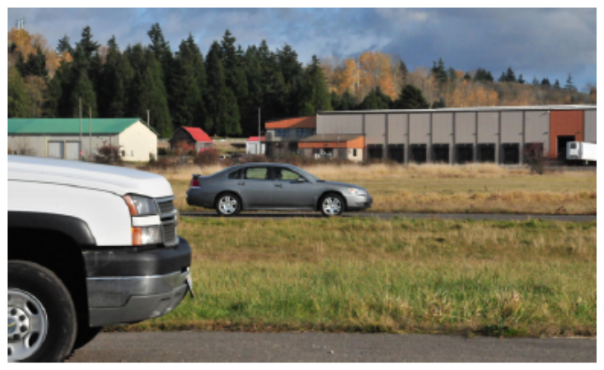
Testing Environments

Slide 15
Attacks
All the attacks used the above-mentioned methodology to determine the message for each function
The authors modified the code to replay the messages to have the desired effect
The details on how to modify the code etc. are omitted from the paper

Slide 16
Power of Exploits
Control of radio, disable user control, increase volume, etc.
Display arbitrary messages on the instrument panel cluster
Honk the horn, lock doors, shoot windshield fluids etc.
Boost engine RPM, disturb engine timing, disable all cylinders
Deploy airbags
Lock individual brakes, release brakes, prevent enabling of brakes
Turn on/off fans and AC, Control lights
Make an arbitrary offset to reported speed
Self destruct, self-wiping code

Slide 17
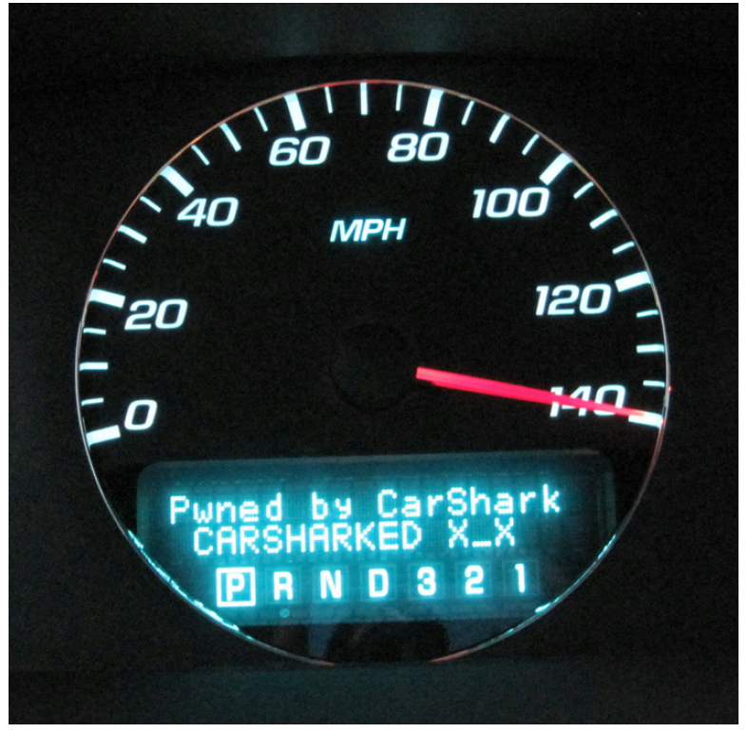
Hacked Car
Displaying an arbitrary message and a false speedometer reading on the Driver Information Center.
Note that the car is in Park.

Slide 18
Second Case Study
Internal networks in cars are insecure but there has been insufficient study of attack surfaces for those networks.
The authors provide a comprehensive experimental view of current status with two experimental cars.
Exploitation is shown to be possible through a number of pathways including mechanics tools, CD players, Bluetooth, and cellular radio.
[Checkoway 2011]
Notes:
Abstract
Modern automobiles are pervasively computerized, and
hence potentially vulnerable to attack. However, while
previous research has shown that the internal networks
within some modern cars are insecure, the associated
threat model—requiring prior physical access—has
justifiably been viewed as unrealistic. Thus, it remains an
open question if automobiles can also be susceptible to
remote compromise. Our work seeks to put this question
to rest by systematically analyzing the external attack
surface of a modern automobile. We discover that remote
exploitation is feasible via a broad range of attack vectors
(including mechanics tools, CD players, Bluetooth and
cellular radio), and further, that wireless communications
channels allow long distance vehicle control, location
tracking, in-cabin audio exfiltration and theft. Finally, we
discuss the structural characteristics of the automotive
ecosystem that give rise to such problems and highlight
the practical challenges in mitigating them.

Slide 19
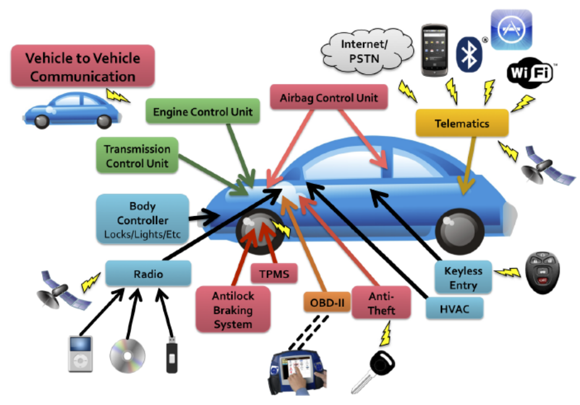
Threat Model
Previous paper required physical connection to the OBD port of the car. By itself this could be viewed as a weak threat model. Authors explore other three more general avenues for access.
Indirect physical – Audio CD, USB, iPod
Short Range Wireless
  Bluetooth devices (cell phones), WiFi Access Points
  Remote Keyless entry, RFID car keys
  Wireless tire pressure monitoring sensors
Long Range Wireless
  Telematics Units Broadcast channels like radio
Notes:
Telematics units: Ford’s Sync, GM’s OnStar, Toyota’s SafetyConnect, Lexus’ Enform, BMW’s BMW Assist, and Mercedes-Benz’ mbrace

Slide 20
Media Player Attack
These two features together allow a buffer overflow:
  One of the file read functions makes strong assumptions about input length, and
  There is a path through the WMA parser (for handling an undocumented aspect of the file format) that allows arbitrary length reads to be specified
Authors developed their own native code debugger for the media player to determine how to overwrite function pointers as well as contents of the state variables
They modified a WMA audio file such that, when burned onto a CD, it plays perfectly on a PC but sends arbitrary CAN packets of attacker’s choosing when played by the car’s media player

Slide 21
PassThru for OBD-II
Since 2004, the Environmental Protection Agency has mandated that all new cars in the U.S. support the SAE J2534 “PassThru” standard.
Windows API that provides a standard, programming interface to communicate with a car’s internal buses.
It is typically implemented as a Windows DLL that communicates over a wired or wireless network with the reprogramming and diagnostic tool called the “PassThru device”.
The device consists of a popular SoC microprocessor running a variant of Linux as well as multiple network interfaces, including USB, WiFi, and a connector for plugging into the car’s OBD-II port.

Slide 22
Attack 1 on OBD-II PassThru
After booting up, the device periodically advertises its presence by sending a UDP multicast packet on each network to which it is connected, communicating both its IP address and a TCP port for receiving client requests.
Communication between the client application and the PassThru device is unauthenticated; it relies on security of the communication link (e.g. WiFi).
An attack on this network can reprogram the PassThru device and send it instructions to upload malicious software to the car.

Slide 23
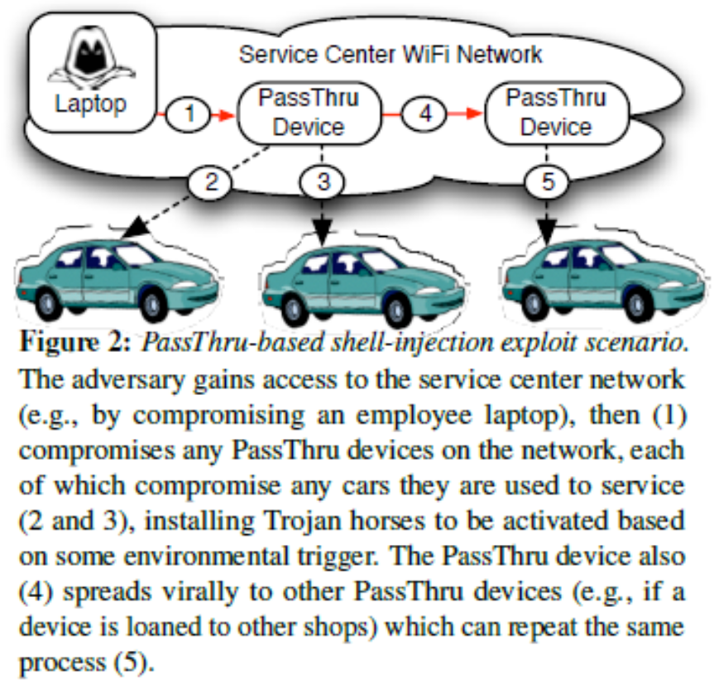
Attack 2 on OBD-II
The PassThru device exports a proprietary, unauthenticated API for configuring its network state (e.g., for setting with which WiFi SSID it should associate).
Input validation bugs in the implementation allow an attacker to run arbitrary Bourne Shell commands via shell-injection.
Underlying implementation had telnet, ftp and nc (netcat) which could be used to open more connections (exacerbated by a poor choice of root password).
Made a worm that actively seeks out and spreads to other PassThru devices in range.

Slide 24
Bluetooth Attacks
A popular embedded implementation of the Bluetooth protocol stack and a sample hands-free application were present in the car.
The interface to this program and the rest of the telematics system appeared to be custom-built.
In the custom interface code, over 20 calls to strcpy were present, providing opportunities for buffer attacks.
Explored and found one such attack.
Attack requires the device to be paired with the car.
Notes:
The size of the available buffer is small. Can creates a new shell on the telematics unit from which it downloads and executes more complex code from the Internet via the unit’s built-in 3G data capabilities.

Slide 25
Pairing attack on Bluetooth
Attacker must learn car’s Bluetooth MAC address
  One can sniff it when the car’s Bluetooth starts
  One can also sniff it via a previously paired device (owner’s cell phone)
After initiating the pairing request on the MAC address, car requires the user to enter the PIN number on the phone
Using a simple laptop to issue pairing requests, one can brute force this PIN at a rate of 8 to 9 PINs/min for an average of 10 hours per car.
This requires a significant effort in development time and an extended period of proximity to the vehicle, but might have promise in a garage.

Slide 26
Long range - Cellular
Telematics unit is equipped with a cell phone interface supporting voice, SMS and 3G data.
Unit relies on the voice channel for critical telematics functions such as crash notification.
Manufacturer uses the Airbiquity aqLink software modem to covert between analog waveforms and digital bits.
aqLink software is common to virtually all popular North American telematics offerings today.
On top of the aqLink modem is the telematics unit’s own proprietary command protocol.
The authors reverse engineered this protocol.

Slide 27
Cellular Gateway Vulnerability
AqLink code explicitly supports packet sizes up to 1024 bytes.
The custom code assumes that packets will never exceed 100 bytes (presumably since well-formatted command messages are always smaller).
Leads to an exploitable stack-based buffer overflow vulnerability.
Attack uses lowest level of the protocol stack to bypass higher-level authentication checks.
Hard to deploy directly – buffer overflow required sending over 300 bytes.
aqLink protocol has a maximum effective throughput of about 21 bytes a second so it takes 14 seconds to transmit.
However, the protocol closes connection if there is no response in 12 seconds.

Slide 28
Buying More Time
First command message sent by the vehicle to the vendor Telematics Call Center (TCC) is a “random”, three byte authentication challenge packet.
The TCC hashes the challenge along with a 64-bit pre-shared key to generate a response to the challenge.
For certain challenges (roughly one out of every 256), carefully formatted but incorrect responses will be interpreted as valid.
After playing many times, one can authenticate oneself to the car and change the timeout from 12 seconds to another value to enable the buffer overflow capability.

Slide 29
Remote Monitoring
Modified the telematics unit to support an IRC client
Showed how attackers controlling the audio system could record conversations in the car
Due to the high bandwidth, they were able to easily upload the saved files using FTP provided by the telematics unit.
Attackers could have the car periodically “tweet” the GPS location of the vehicle.

Slide 30
References
[Koscher 10]
[Checkoway 11]
Experimental Security Analysis of a Modern Automobile, Karl Koscher, Alexei Czeskis, Franziska Roesner, Shwetak Patel, Tadayoshi Kohno (UW), Stephen Checkoway, Damon McCoy, Brian Kantor, Danny Anderson, Hovav Shacham, and Stefan Savage (UCSD). IEEE S&P 2010.
Comprehensive Experimental Analyses of Automotive Attack Surfaces, Stephen Checkoway, Damon McCoy, Brian Kantor, Danny Anderson, Hovav Shacham, and Stefan Savage (UCSD), Karl Koscher, Alexei Czeskis, Franziska Roesner, and Tadayoshi Kohno (UW). USENIX Security 2011.

Slide 31
Upcoming Lectures
Frank Li (Berkeley)
Improving Security at an Internet Scale: A Data-Driven Approach
Apr 2 from 11:00 AM to 12:00 PM at B02 CSL (optional attendance)
Bo Li: Automotive AML
Apr 4 from 11:00 AM to 12:15 PM at SC1105 (usual place) Please attend!

Slide 32
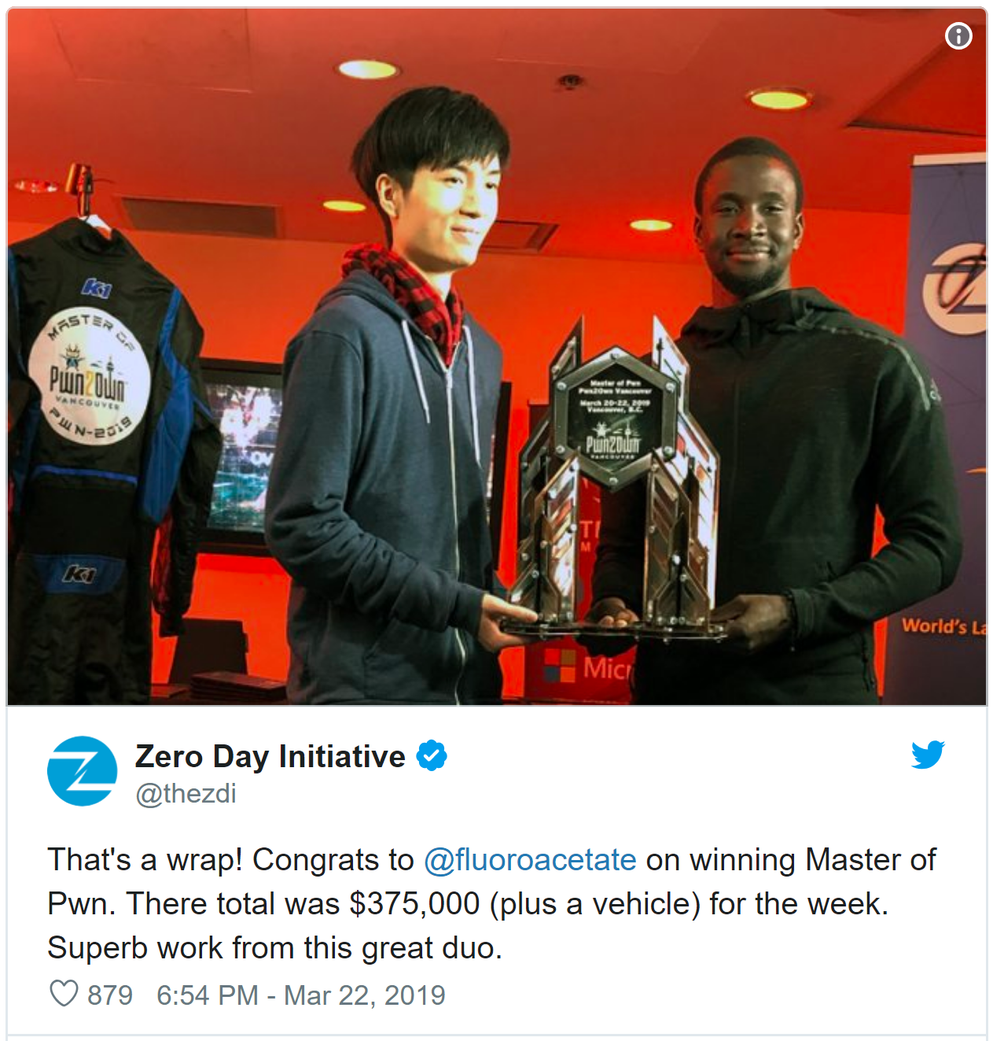
Hacking Automobiles Today
These 20-something hackers won $375,000 and a Model 3 for finding a Tesla bug, March 22, 2109

Slide 33
Discussion
There has been a drop in theft levels for cars. Suggest ideas for monetizing compromises of computerized vehicle systems.
  Here’s Why Stealing Cars Went Out of Fashion
What changes are occurring in the automotive sector?
  How might these changes affect security and privacy?
What threats might exist for other safety-critical embedded devices like medical devices?

